Slide 1
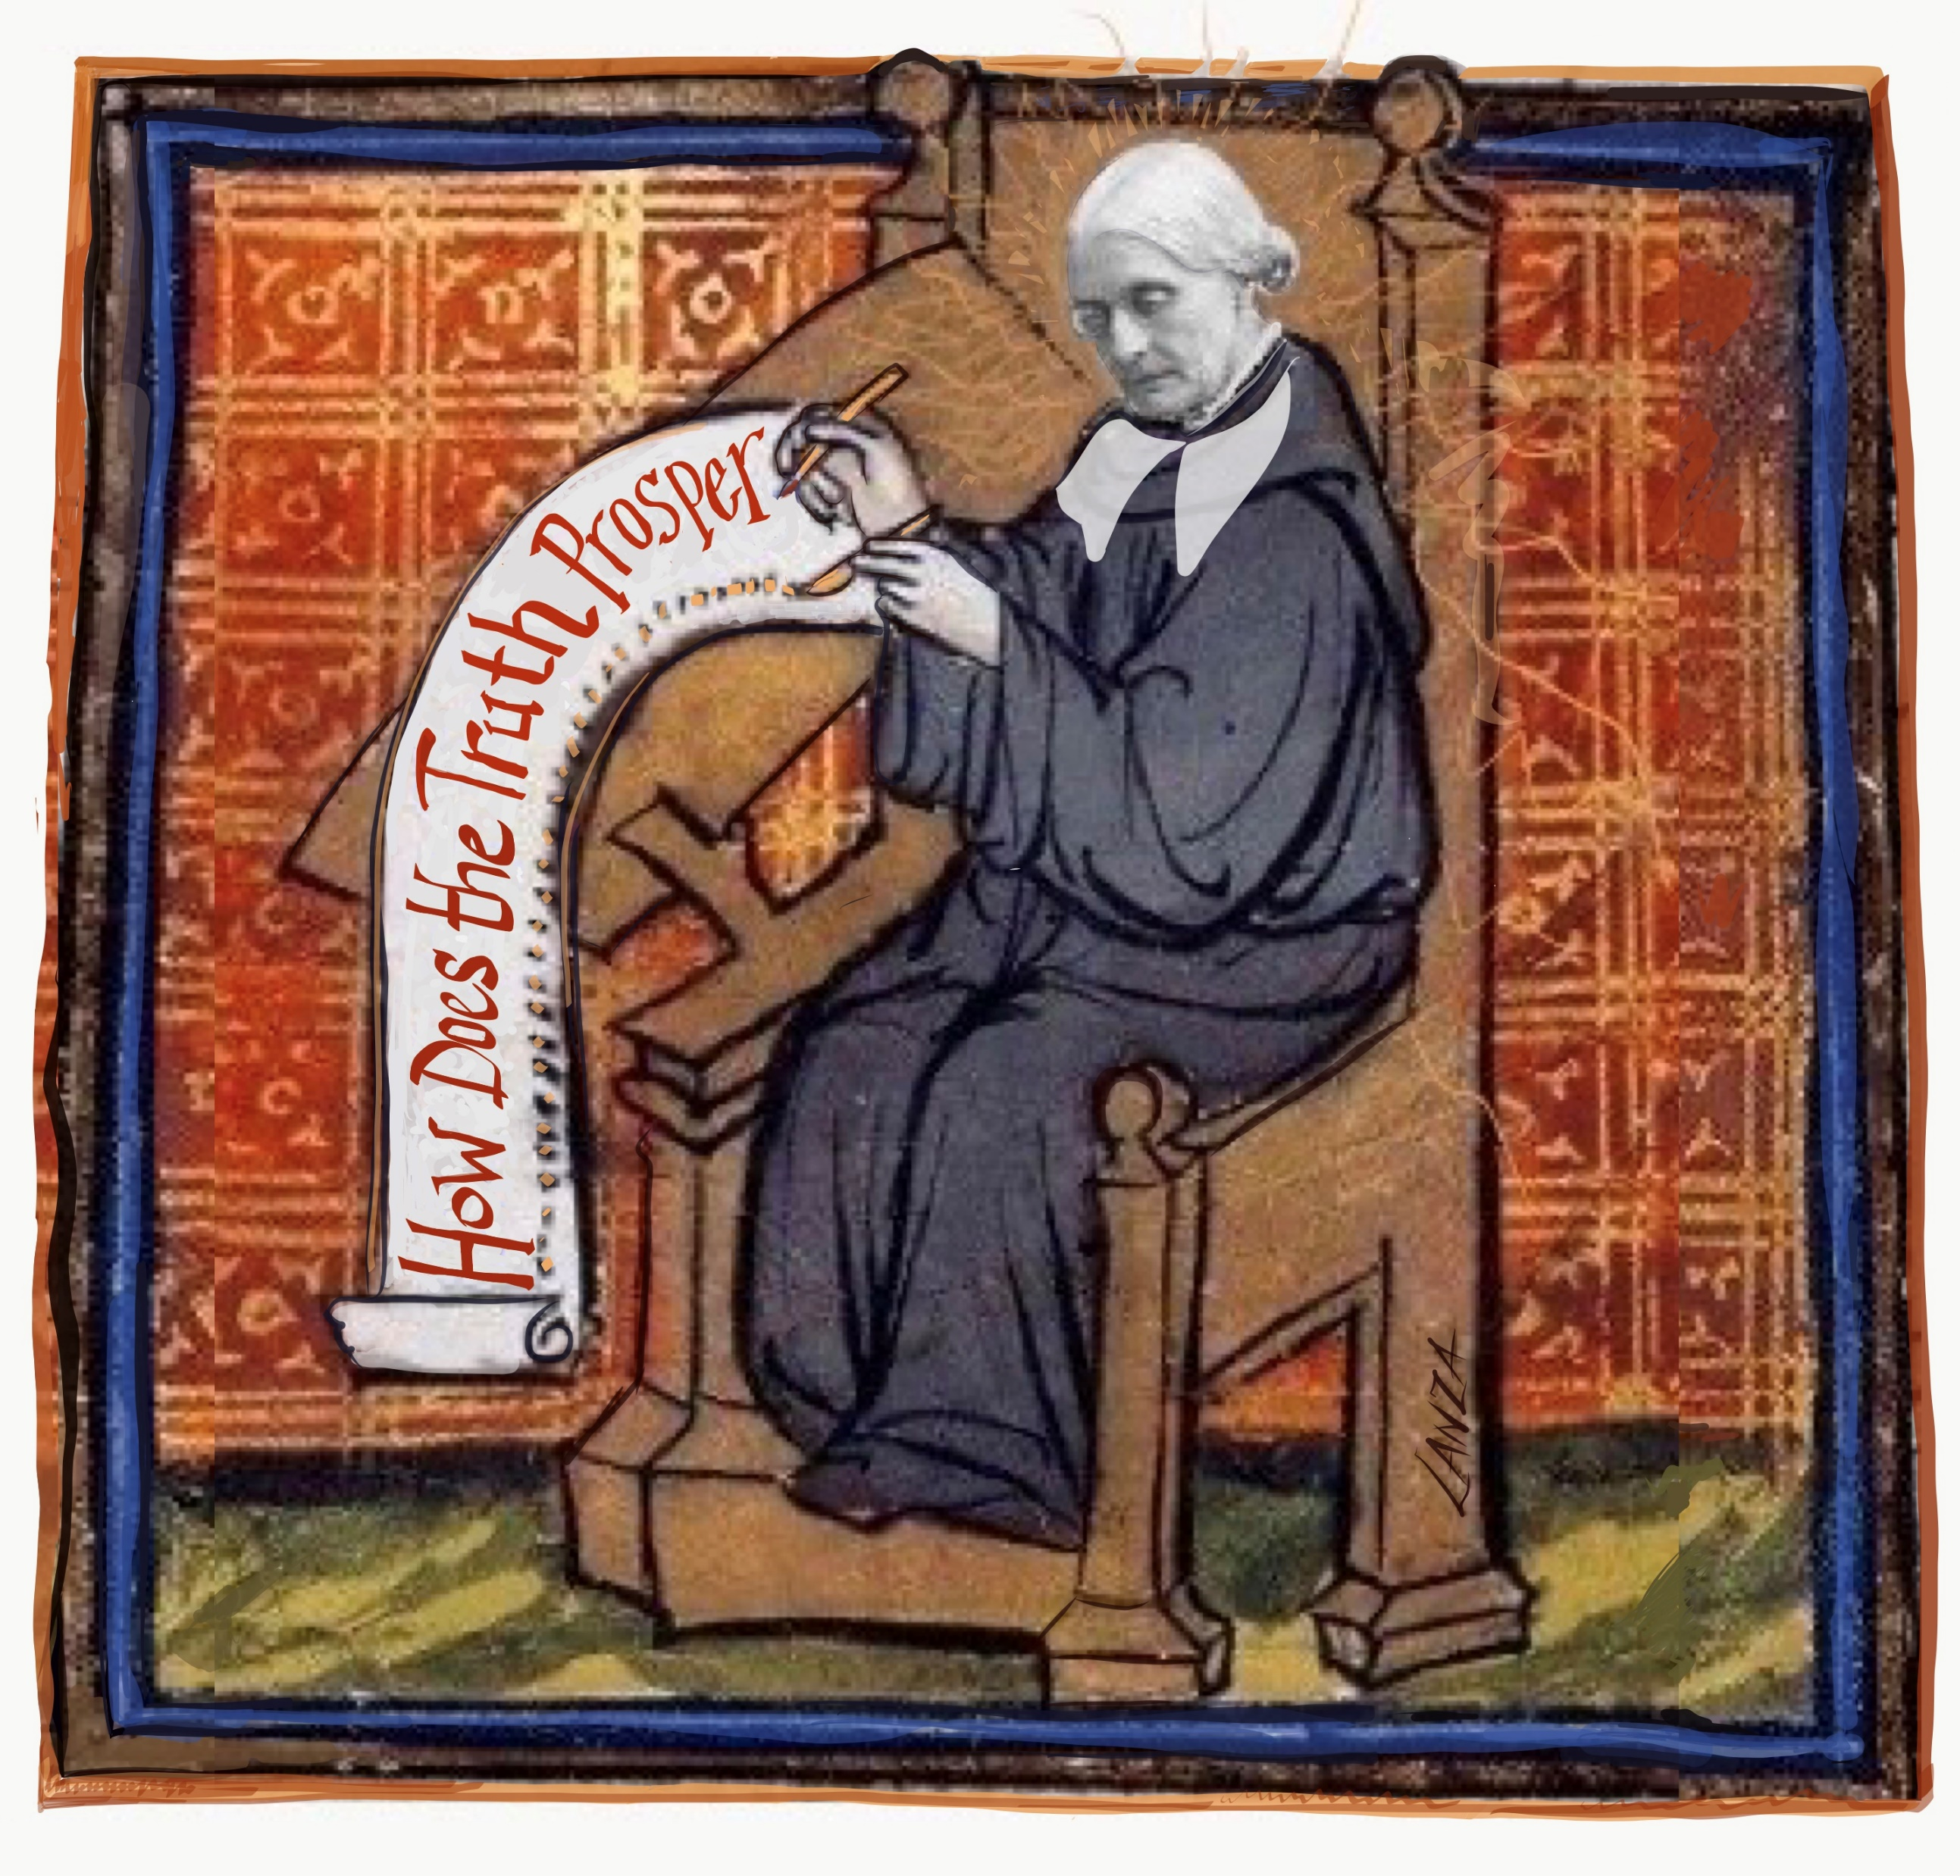
Lanza, reporting to you from the field
Abington Quarterly Meeting
Communications Coordinator
L. Lanza
AbingtonQtrCommunications@gmail.com
215. 990-3196

Slide 2
My job
Getting to know the meetings
Interview, survey and consult
Attend listen committee meetings
Themes I’ve heard
Focus today on highlights

Slide 3
ABINGTON QUARTER HAS 9 MEETINGS
Quaker Meetings in Abington Quarter:
Abington Byberry Gwynedd Horsham Norristown Plymouth Richland Unami
Upper Dublin

Slide 5
Quaker Meetings in Abington Quarter
Abington Byberry Gwynedd Horsham Norristown Plymouth Richland Unami
Upper Dublin
Each meeting has a distinct character, there is something for every Seeker in this Quarter.
In strategic planning and marketing – it is useful to consider an organization’s
Strengths, Weaknesses, Opportunities and Threats.
And I started to hear and see many common SWOTs (as well as unique ones)

Slide 6
WHAT IS THE PURPOSE OF GATHERING TODAY?
Four times a year,
Abington Quarterly Meeting
brings together Friends
from Quaker meetings across our area
to share, learn, and support common interests and leadings.

Slide 7
Common Interests include
Worship, Ministries, Social Life, Learning & Serving in Community
AND
A concern for the Quaker future
In the USA ten years 25% fewer Quaker meetings
The Quarter responded by investing in collective action through the Communications Committee, and some meetings are and have done strategic planning etc.

Slide 8
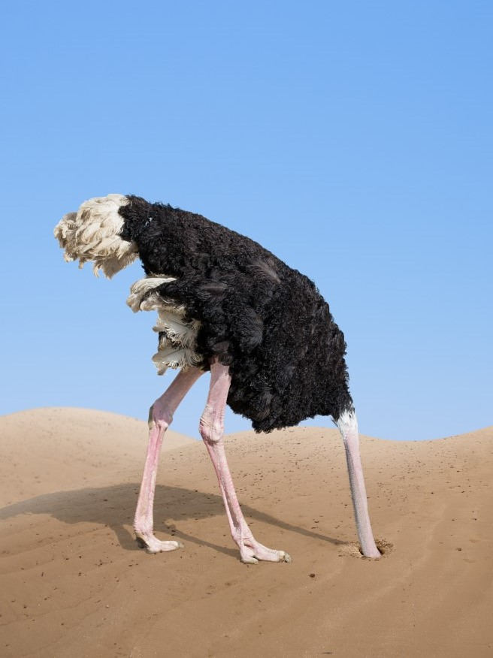
THE BOTTOM LINE
We are in it together.
Even meetings that are doing well now – are impacted by the changing demographics.
The key to sustainability lies in working together - sharing skills & resources, so we can focus on doing the real work of our meetings.

Slide 9
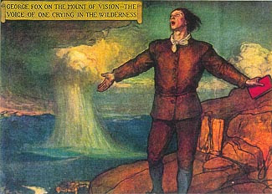
Small and struggling meetings don’t have the capacity to respond to opportunities for growth – so what can we do?
Get ready to accept
being uncomfortable and try new ways of doing the meeting.

Slide 10
Try Looking Through Others’ Eyes
Visit your meeting as if you were new.
Look at your signage, is it clear where to go? Did anyone greet you or was anyone actively looking to welcome new people?
Did they stay a few minutes after MFW started to catch first timers who might be late?
Is there a guest book and is it visible so visitors can easily see it? If so – how does the meeting use the information? Does anyone actually reach out to newcomers?
Was there a social hour / hospitality / tea table after MFW?
Do you think people would feel welcomed and at ease at the meeting?
Try new things. Be open to seeing where the old ways are not always serving the goals of inreach and outreach.
Don’t assume something failed – there is always something to learn from each effort. Something that didn't work before might be perfect now.
Take a meeting inventory – look for where there is joy and use that to feed the spirit. A joyful meeting is very attractive!

Slide 11
This Little Light of Mine
Accompanied / co-led by Carl Baron of Gwynedd Friends!

1
This little light of mine
I’m going to let it shine
Oh, this little light of mine
I’m going to let it shine
This little light of mine I’m going to let it shine
Let it shine, let it shine, let it shine

2
Everywhere I go
I’m going to let it shine
Everywhere we /I go
We’re / I’m going to let it shine
Everywhere we go
We’re going to let it shine
Let it shine, let it shine, let it shine

3
Hide it under a bushel? No!
I’m going to let it shine
Hide it under a bushel? No!
We’re going to let it shine
Hide it under a bushel? No!
We’re going to let it shine
Let it shine, all the time, let it shine.

Last time folks!
4
This little light of mine
We’re / I’m going to let it shine
Oh, this little light of mine
We’re / I’m going to let it shine
This little light of mine
We’re / I’m going to let it shine
Let it shine, let it shine, let it shine

Slide 12
Build the Capacity of Meetings
Is caring for each other
The single most critical thing to do before you start inviting in a lot of people – is to make sure you have the ability to WELCOME them.
Recognize, thank and support the work of the people who are contributing their time & talent
Grow existing friends. Identify underutilized Friends in the meeting and
friends who have stopped coming. Reach out. Let them know they are missed.
Take the time to know them. Then include them.
Encourage / welcome inexperienced friends to shadow, be part of a committee. Learn on the job. Let them find what clicks!
FINALLY: Be generous with the friends that are showing up and help them - don’t let them have to figure it out alone.

Slide 13
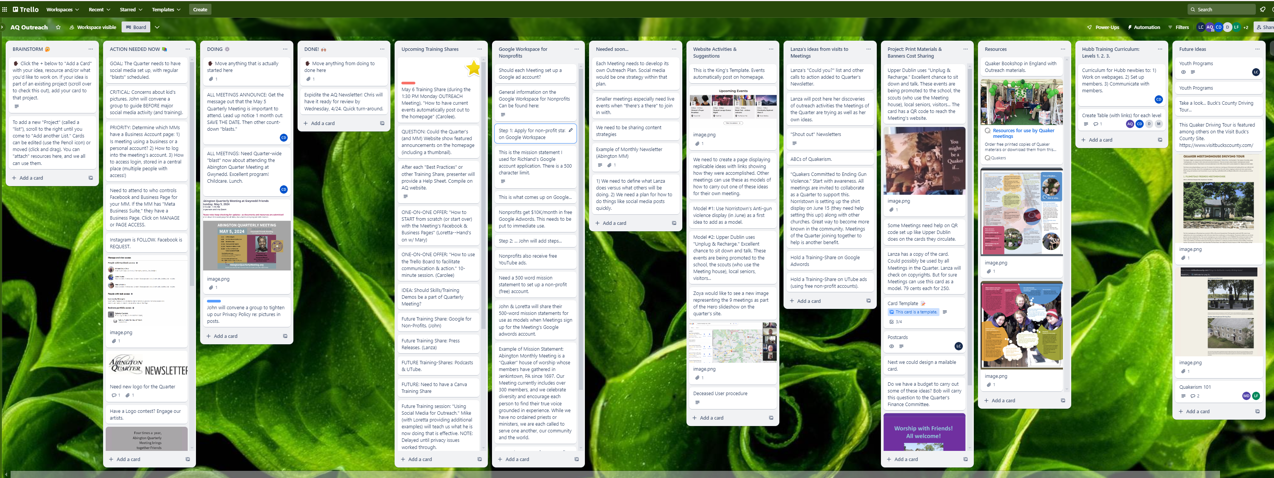
LEARNING FROM EACH OT HER
The Abington Quarter Communications Committee works collaboratively on learning, developing and implementing the communication, ‘in reach’ and ‘outreach’ tools and strategies that are essential to assuring the future of our Quaker meetings.
Together, we are stronger.
Screenshot of AQ Communications Committee Trello board. A place filled with ideas, projects, findings, best practices, resources… Thanks to Carolee Duckworth of Plymouth for incredible notetaking!

Slide 14
We are expanding and we need you! The Abington Quarter Communications Committee is seeking NEW or RETURNING friends to join our committee network. We learn and implement collaboratively on communication tools and strategies for ‘in reach’ and ‘outreach’. These are essential to assuring the future of our Quaker meetings. Together, we are stronger. Here is the ask: We ask each meeting to identify two new (or returning) friends to join Ideally, one will be familiar with your meeting’s communications, outreach or programs. We encourage meetings seek out an underutilized friend(s) who is willing to contribute on any level. All are welcome. We want to share the Abington Quarter with new folks! Limited time availability or technical experience is not a barrier. Attenders and young people are WELCOME to join us. Many vital tasks, like proofing websites, creating content can be done independently or in a small group format. Questions? Contact: Bob Reiff, AQCC Convener and L. Lanza, AQM Communications Coordinator Robert Reiff abingtonquarter@gmail.com Lanza, AQM Comm. Coord. abingtonqtrcommunications@gmail.com 215-990-3196

Slide 15
LEARNING FROM EACH OTHER
One of the many emerging activities of the AQ Communications Committee is a peer-learning Outreach Skills series.
Train the Trainer: the purpose is for friends in the Quarter to share & learn useful skills- and in turn, pass it on to others in their meeting.

Slide 16
… require strategy. Who is your target audience? That’s where to leave the cards. Make sure that you always include…
Outreach Campaigns

Slide 17
You May Be a Quaker If…
… contact info that is working and plan to respond to inquiries promptly and with warmth.

Slide 18
PLAN EVENTS and Programs
Identify all the things your meeting already does
Tell that story – on website, welcome sign inside your meetinghouse, in local papers
EVERYWHERE YOU GO!
Plan some Events for Building community: Friendly Eights, Quakerism 101, and small group activities for new folks to join in

Slide 19
Using Press and News Releases local outlets

Slide 20
Using Social Media to Appeal Kinds of Seekers
Byberry’s Instagram

Slide 21
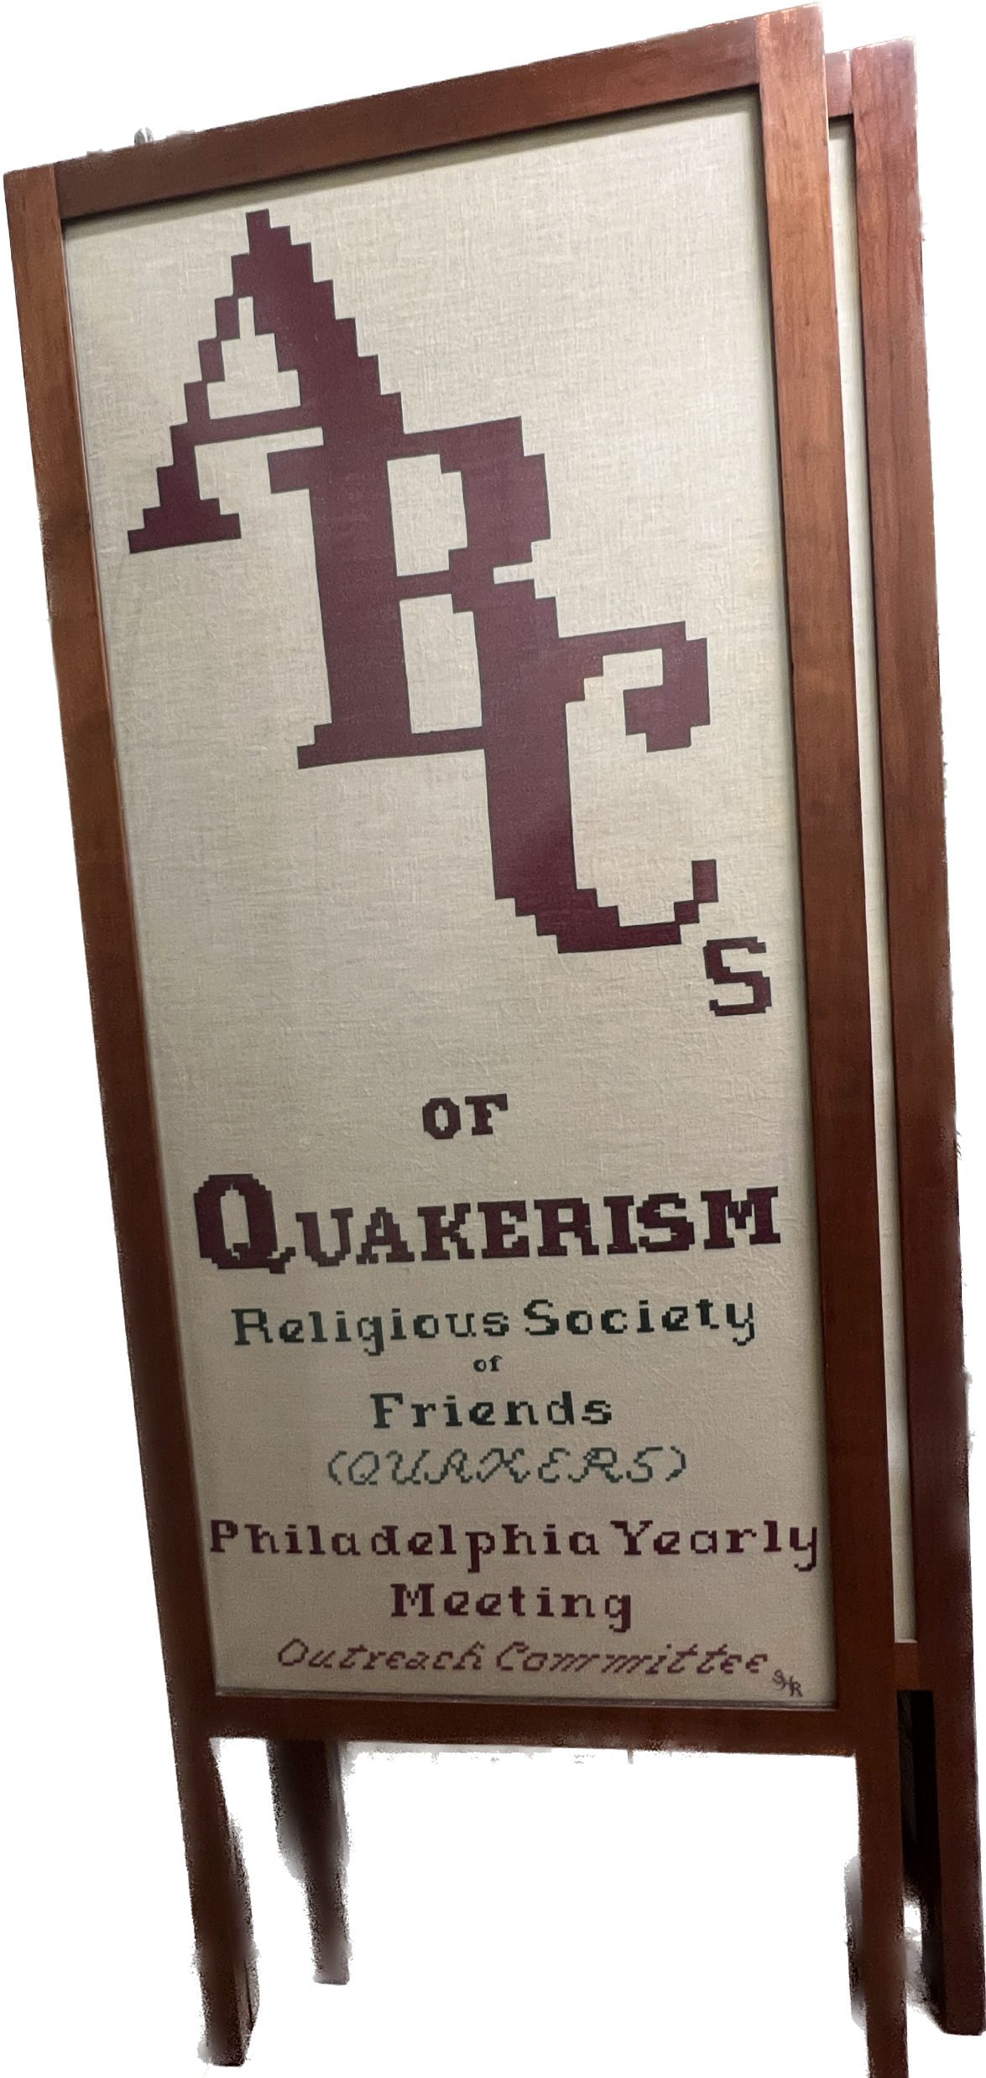
Print materials like: ABCs of Quakerism by Sally Rickerman

Slide 22
MINISTRIES AS OUTREACH
Announcing a New PYM Collaborative! ​​​​​
Friends Ending Gun Violence
Friends Ending Gun Violence is a recently formed Collaborative within the Philadelphia Yearly Meeting.
We hope that your members and attenders will join the efforts of this Collaborative to build a network of Friends who will respond and mobilize to bring about an end to gun violence.
FEGV is collaborating with other groups organized for the same purpose such as Heeding Gods Call, With One Voice, Quaker Action Mid-Atlantic Region (QAMAR) and CeasefirePA.
Pamela Yaller, co-clerk, Upper Dublin MM, pamyaller@icloud.com Martha Bryans, co-clerk, Downingtown MM, mbryans26@verizon.net
Above photo: Memorial to the Lost at Upper Dublin Friends.
In June 15, Norristown Friends Meeting will host this Memorial, and on June 22 host a community wide event with speakers, live music and refreshments.

Slide 23
Can you offer a couple hours a month to make a huge difference in your own meeting and the entire Abington Quarter? Diversity of contributions is valued in the AQ Communications Committee:
Are you a member or attender who…
* Loves learning, sharing knowledge, and getting the word out about fun events and Quakerism?
* Do you enjoy sales, marketing and/or community organizing?
* Do you like technical troubleshooting?
* Could you develop social media campaigns?
* Could you teach others how to update the website or Facebook page?
* Could you be a presenter for the Outreach Skills series?
* Would you be the one to learn to use a new technology or apps and pass it on?
* Could you fill out an inventory of your meeting’s potential and existing partners?
* Do you know how to produce community events?
* Could you plan and lead an open house for prospective Seekers?
* Do you like proofreading, checking website for links, and /or brainstorming ideas?
* Do you want to create YouTube or Facebook shorts? Take photos of Quaker Life?
* Would you be interested in working with young people to earn community volunteer credits by doing some content creation?
* Are you able to write some short stories about your meeting?

Slide 24
Following Lunch there will be a Silent Vigil for an Israeli-Palistinian ceasefire now

